Slide 1


Prototype Submission Phase

Slide 2
TEAM NAME and MEMBER DETAILS
1) Chirag Sindhu - business.chiragsindhu@gmail.com
THEME:
Agent Swarms

Slide 3
PROBLEM STATEMENT
Microsoft developers increasingly use AI-assisted coding tools and large-scale code generation systems to speed up software development in complex, distributed systems. While these tools greatly boost productivity, they also pose a major challenge. AI-generated or AI-assisted code is often syntactically correct but semantically weak. This leads to subtle bugs, runtime failures, dependency conflicts, and unintended side effects when the code is integrated into large production codebases.
Modern debugging in these environments is costly and time-consuming. Engineers need to interpret stack traces, reproduce intermittent failures, analyze dependencies across multiple repositories, trace execution flows among services, and validate fixes through repeated testing. In large engineering organizations like Microsoft, systems cover cloud infrastructure, developer platforms, and AI services. Even minor defects can lead to serious reliability, security, or performance problems. Current AI coding assistants mainly focus on code generation and completion, but they lack structured reasoning for systematic debugging, identifying root causes, and verifying fixes.
This creates a gap between generating code and preparing it for production. While AI can quickly produce code, it cannot reliably ensure correctness in dynamic, real-world settings. Developers still need to manually debug, reproduce issues, and validate patches. This slows down release cycles and raises operational costs.
There is an urgent need for an autonomous, multi-step debugging system that can mimic real engineering workflows. It should analyze failures, reproduce bugs, identify root causes, generate corrective patches, and validate fixes through automated testing. Such a system would significantly lessen developer effort, improve code reliability, and help AI-generated software transition safely from rapid prototyping to production-ready deployment in enterprise environments.

Slide 4
SOLUTION
We Intoduce Project MYTHEOS
Multi-agent Yielding Traceback, Hypothesis, Evaluation, Optimization, and Solution
How it helps to solve the problem?
MYTHEOS fills the reliability gap in modern software engineering. AI can generate code faster than humans can check it. Instead of relying on one large language model to guess a fix, MYTHEOS employs a group of specialized agents that work together like a strong engineering team.
Automated Investigation: It eliminates the manual drudgery of reading thousands of lines of logs and stack traces.
Verification-First Approach: Unlike standard assistants, it must reproduce a bug before suggesting a fix, ensuring the root cause is truly understood.
Impact Metrics for Analysis
To measure the success of MYTHEOS, we track:
Mean Time to Resolution (MTTR): Reduction in the time from bug report to verified pull request.
Root Cause Accuracy: Comparison between AI-identified root causes and human-verified causes.
Regression Prevention Rate: Number of bugs caught by the Test Agent before the code is merged.

Slide 5
Frameworks, Tools, and Technology Stack
Orchestration Layer: Agent Orchestration (own) or Microsoft OpenAPI (chosen for stateful, multi-agent cycling and complex decision-making).
LLM Core: Azure OpenAI (GPT-4o / o1-preview / Deepseek 4 flash) for high-reasoning tasks and code generation.
Execution Sandbox: Docker containers (to safely reproduce bugs and run tests in isolated environments).
Code Intelligence: Tree-sitter (for abstract syntax tree analysis) and GitHub/Azure DevOps APIs.
Assumptions: The system assumes access to the repository’s build environment and a comprehensive set of logs/telemetry.
Constraints: Security protocols restrict AI from accessing sensitive production data; it operates only on sanitized logs or staging environments.
Ease of Implementation & Effectiveness
Implementation: Moderate. The complexity lies in the orchestration of the agents and the sandbox environment. However, by leveraging existing GitHub Actions or Azure Pipelines, MYTHEOS can be integrated as a "Bot" that triggers whenever a new Issue is created.
Effectiveness: High. By breaking the problem into micro-tasks (Tracing, Hypothesizing, Testing), the system overcomes the "hallucination" issues of single-agent models, leading to production-grade patches.
Extent of Scalability & Usability
Usability: Designed for seamless developer experience. A developer simply tags @mytheos on a GitHub issue, and the swarm provides a full PR with a root-cause report within minutes.
Scalability: The architecture is cloud-native. Using Azure Container Instances, Microsoft could scale MYTHEOS to handle thousands of concurrent debugging sessions across different product teams (Office, Azure, Windows) simultaneously, with each swarm operating in its own isolated workspace.
Future Scope
Mytheos will be extended to Github Issues and crawling different github repos and finding the issues and resolve them, auto create pull request to update them from the repo’s owner

Slide 6
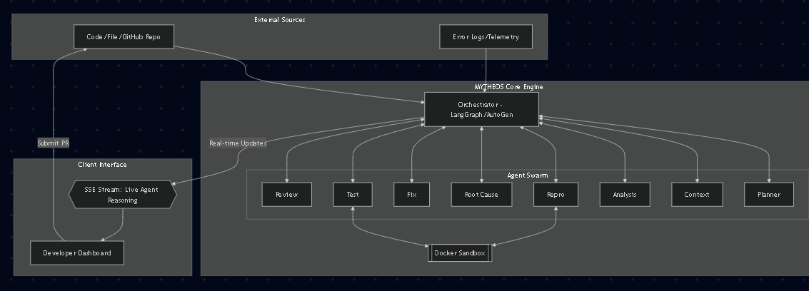
Architecture Diagram
Visualizes the "Hub-and-Spoke" model where a central Orchestrator manages specialized agents. It connects external inputs (GitHub/Logs) to a secure Docker sandbox, ensuring code is tested in isolation before being pushed back to the repository.

Slide 7
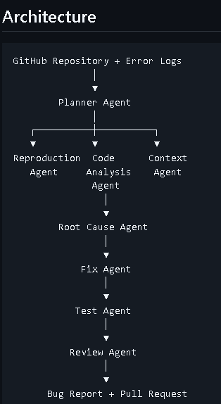
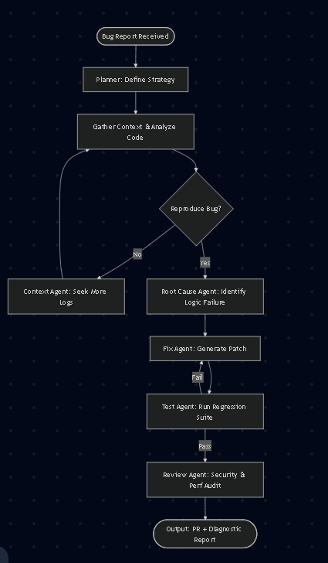
Agents Arch
Agent Thinking process
Maps the non-linear debugging lifecycle. It highlights the critical feedback loop: if the Test Agent identifies a failure in the proposed fix, the system automatically loops back to the Fix Agent to iterate until the solution is verified.

Slide 8
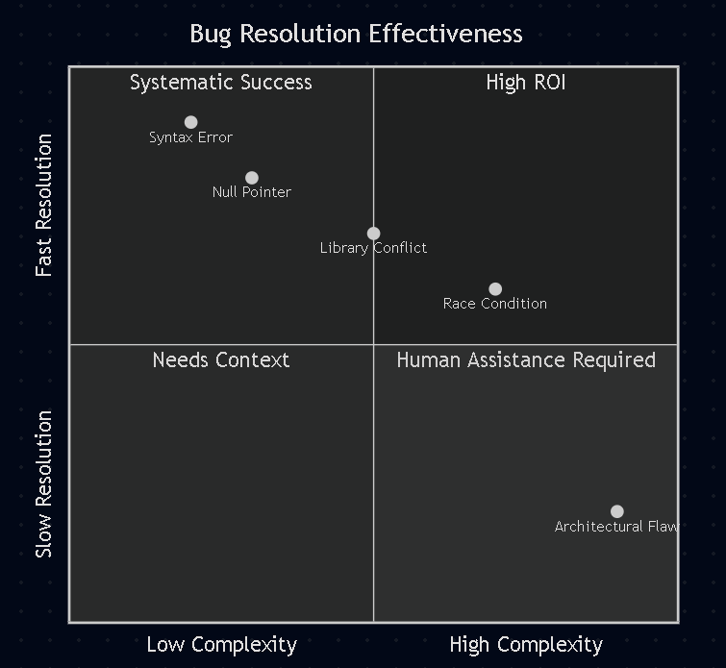
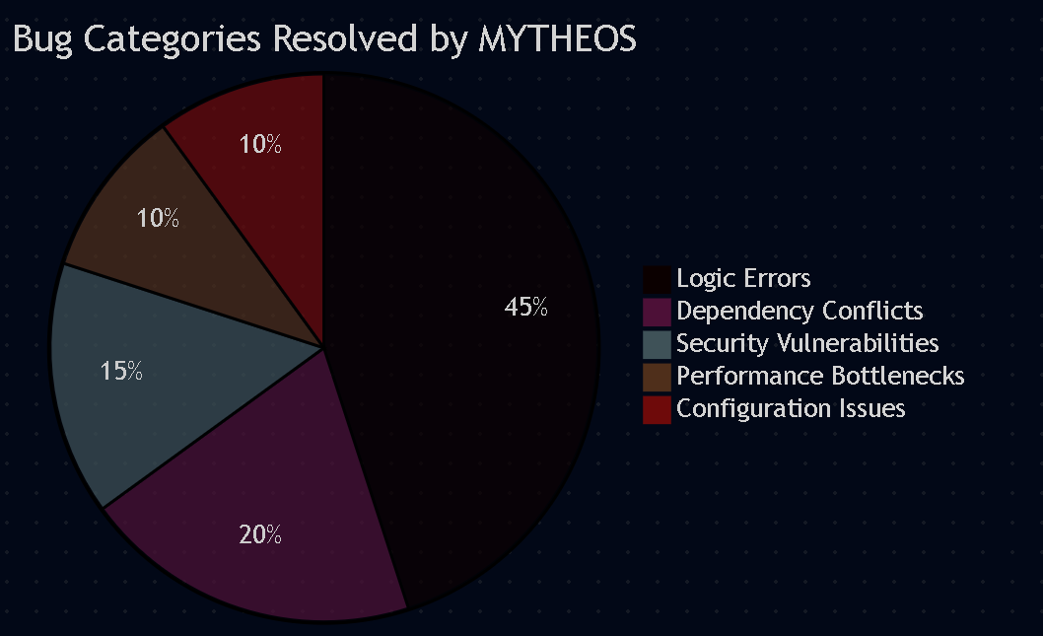
Quadrant Chart: Plots bug complexity against resolution speed, identifying the "Sweet Spot" where the AI provides the highest ROI for complex issues like race conditions.
Pie Chart: Illustrates the distribution of bug types (e.g., Logic, Security, Dependency) to show where the swarm is most effective.

Slide 9
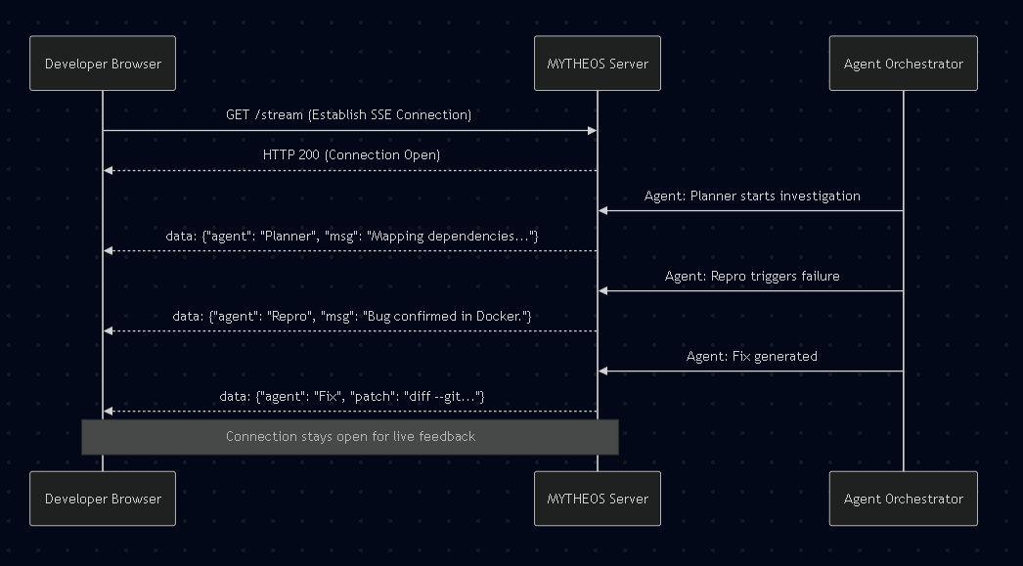
SSE Connections
Demonstrates the real-time communication logic. Instead of waiting for a final result, the SSE stream pushes live "thoughts" from the agent swarm directly to the UI, providing total transparency into the AI's investigation process.

Slide 10
WORKING PROTOTYPE
Live Link: https://nice-field-0b1a01600.7.azurestaticapps.net Live video link: https://youtu.be/QkcsxBdOckE

Slide 11
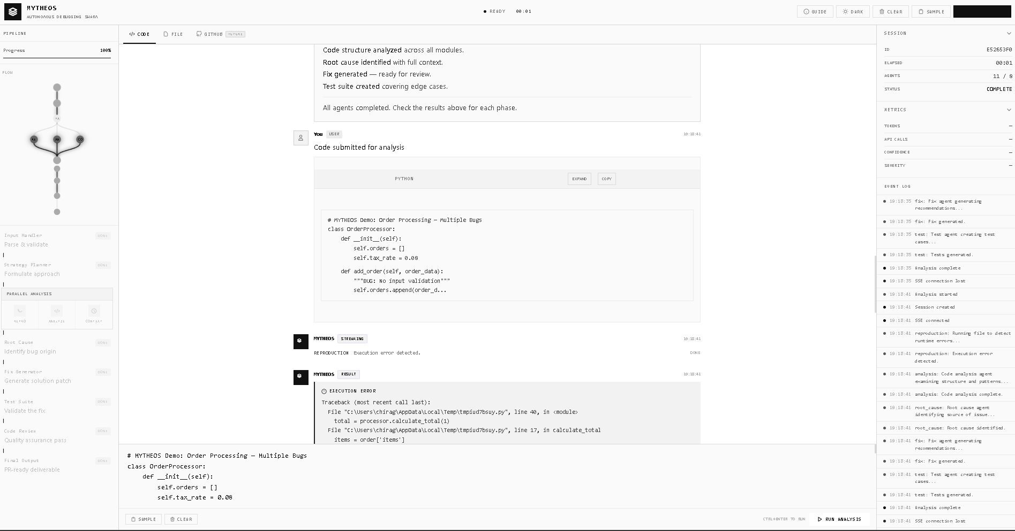
Attachments

